Slide 1

Bank database with access
This is the description of our project.

Slide 2
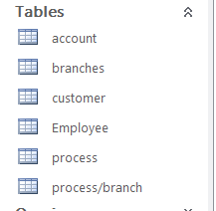
Our project consists of six main tables in which the data necessary for the management of the bank are stored.

Slide 3
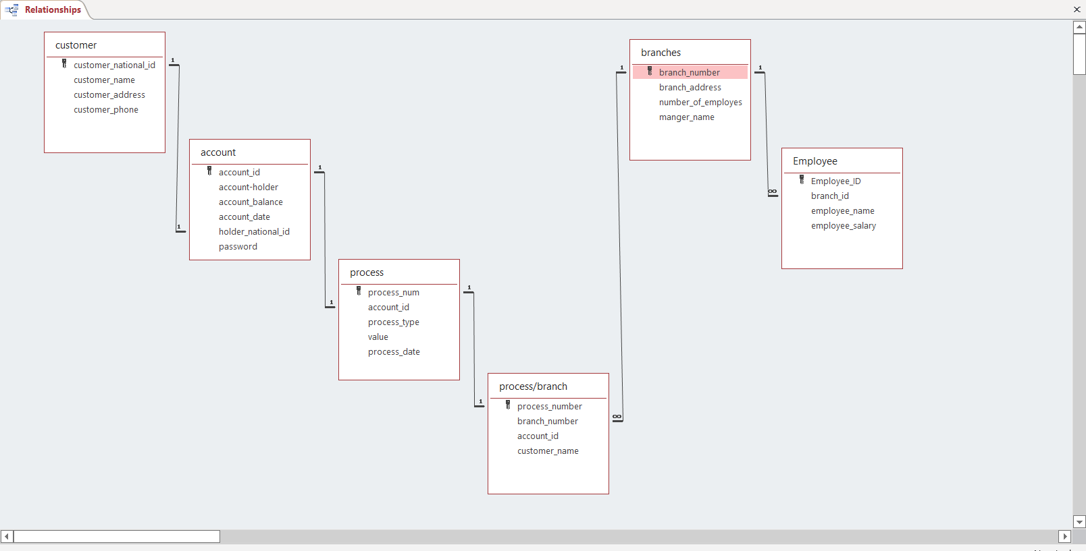
These tables are linked to each other through a set of relationships that we have built.

Slide 4
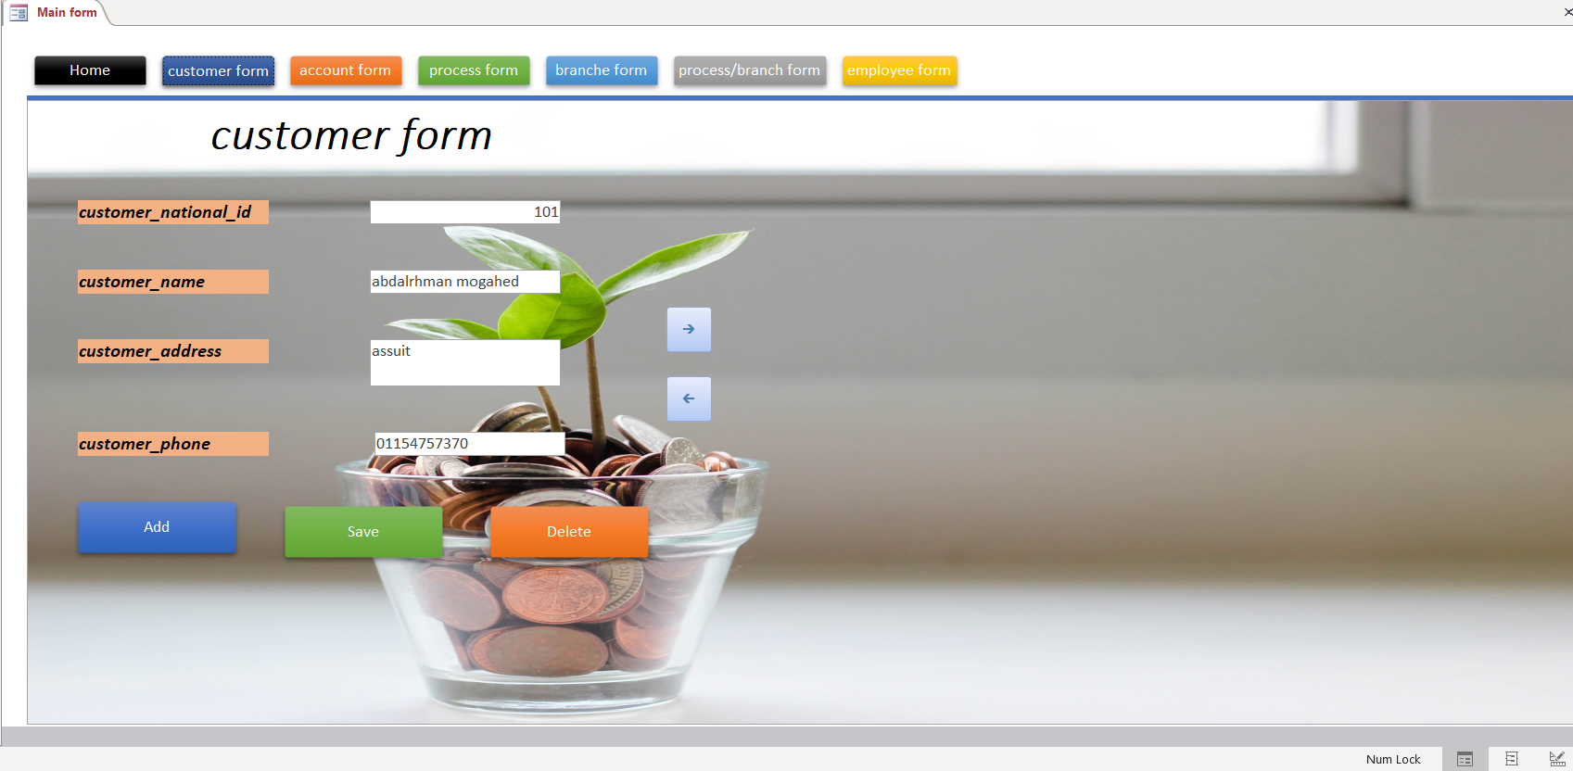
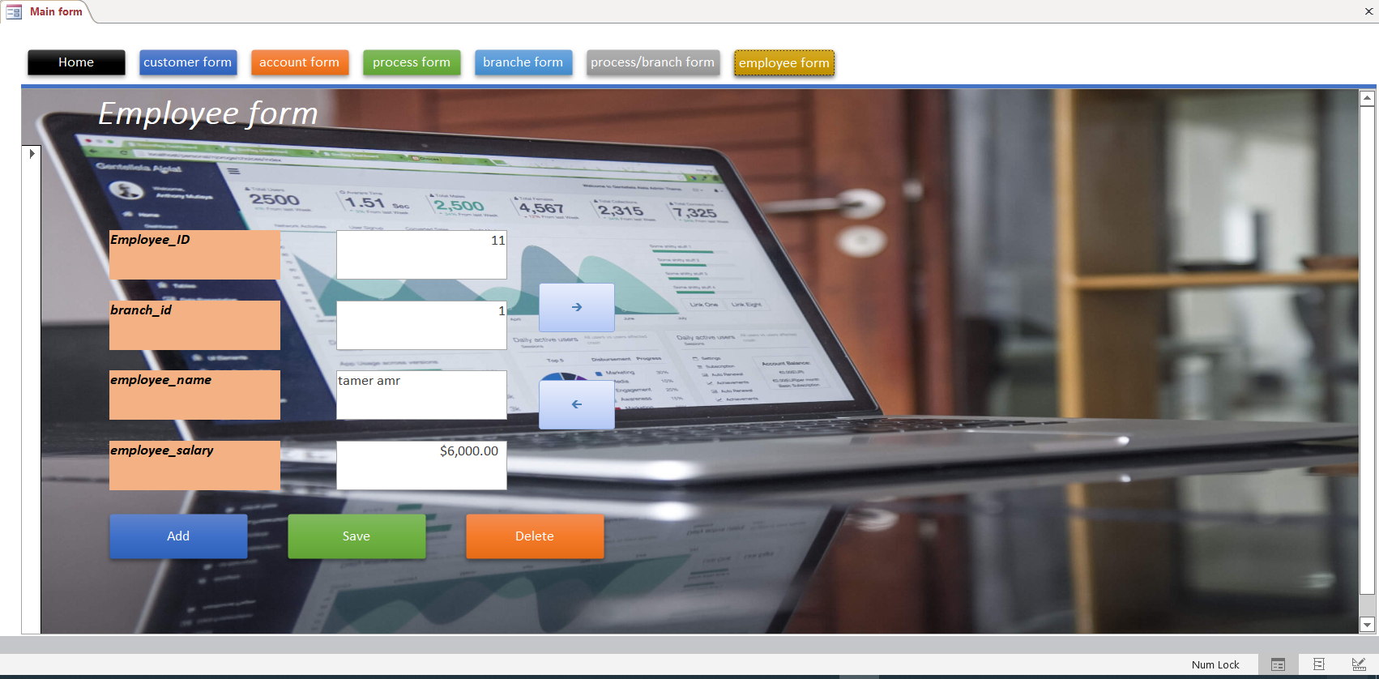
Each table is filled out with the necessary data by the user via the form for each table, and through this form it is also possible to navigate through the fields of the table.

Slide 5
After that, the data stored in the tables can be processed through queries, and through them it is also possible to search for a specific person in the bank, whether he is an employee or a customer, and the data of a specific bank account can also be viewed through the account ID .

Slide 6
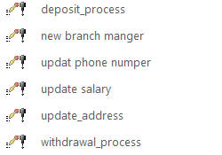
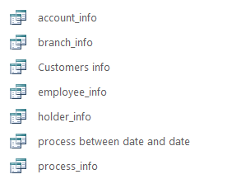
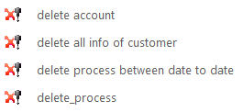
The project includes a lot of queries through which it is possible to modify, delete or display the data in a way that suits the need.

Slide 7
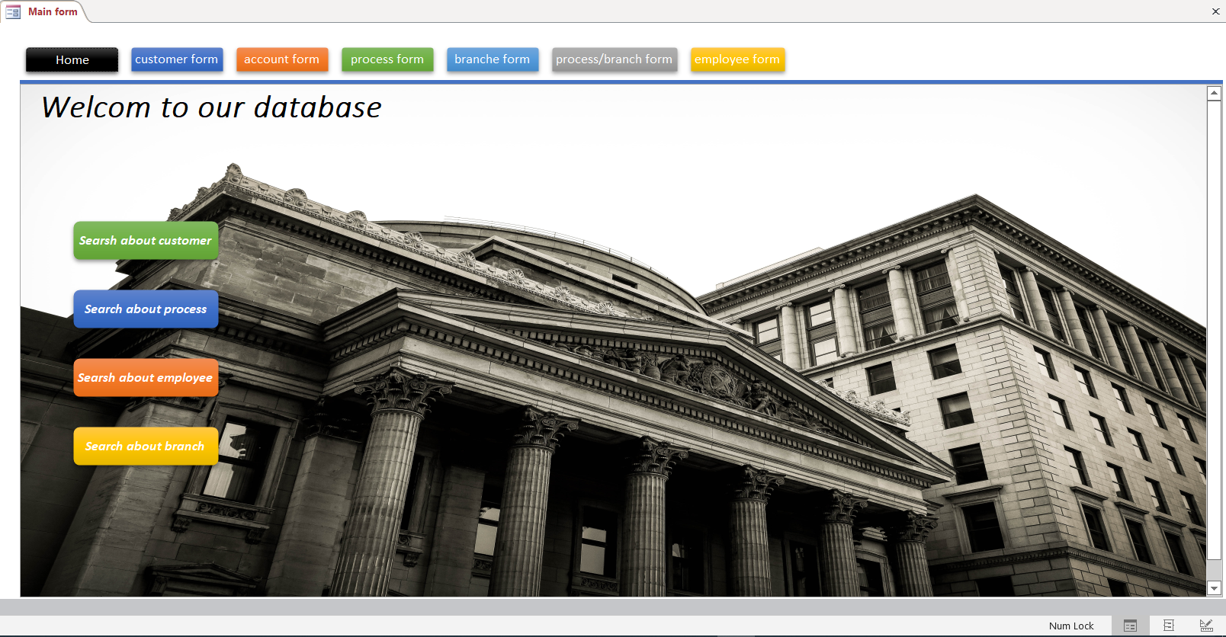
Through queries and forms, we made custom buttons that enable us to search for anything we want from the data stored in the tables, and we put these buttons in the main form.

Slide 8
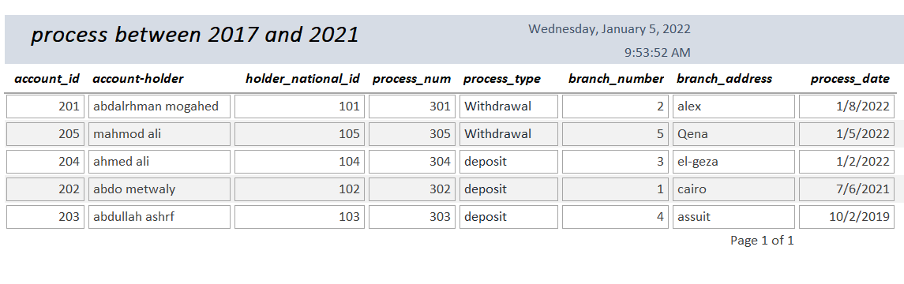
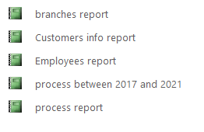
In the end, we made reports through which we can better understand the situation and export the data to other applications.

Slide 9
مجموعة 54 الأعضاء 1- عبدالرحمن علي مجاهد محمد 2- عبدالله علي حسن احمد 3- عبدالرحمن مجدي عبدالعال هلال 4- عبدالرحمن متولي سيد 5- عبدالرحمن شريف حامد 6- عبدالله اشرف محمد مصطفي

